Slide 1

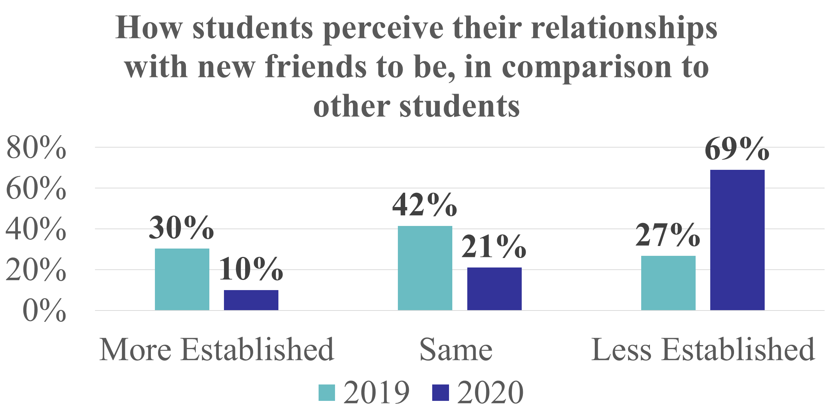

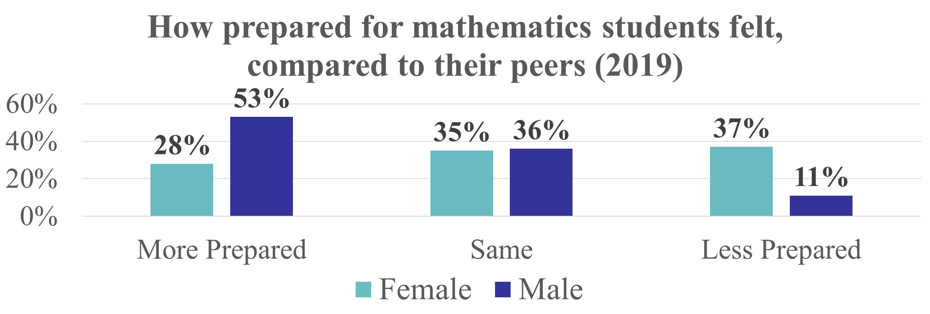
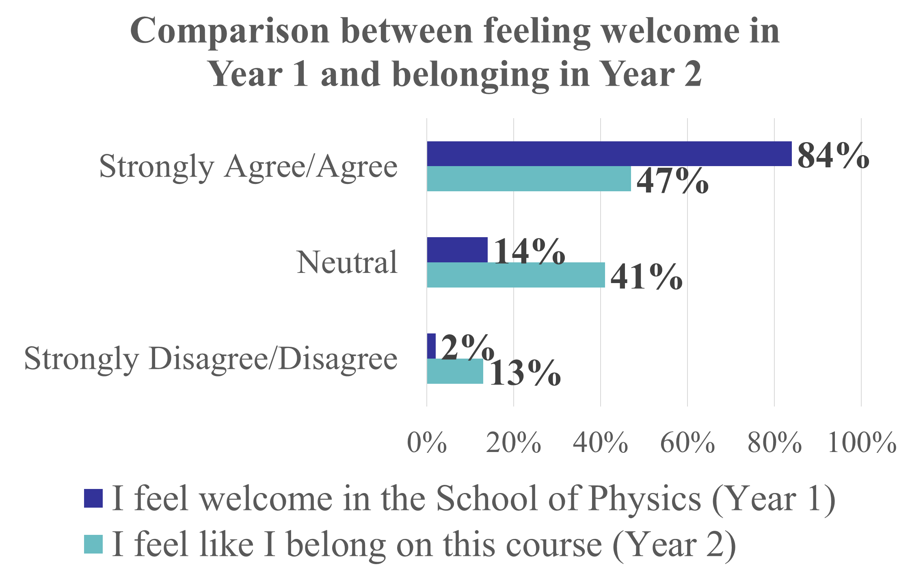
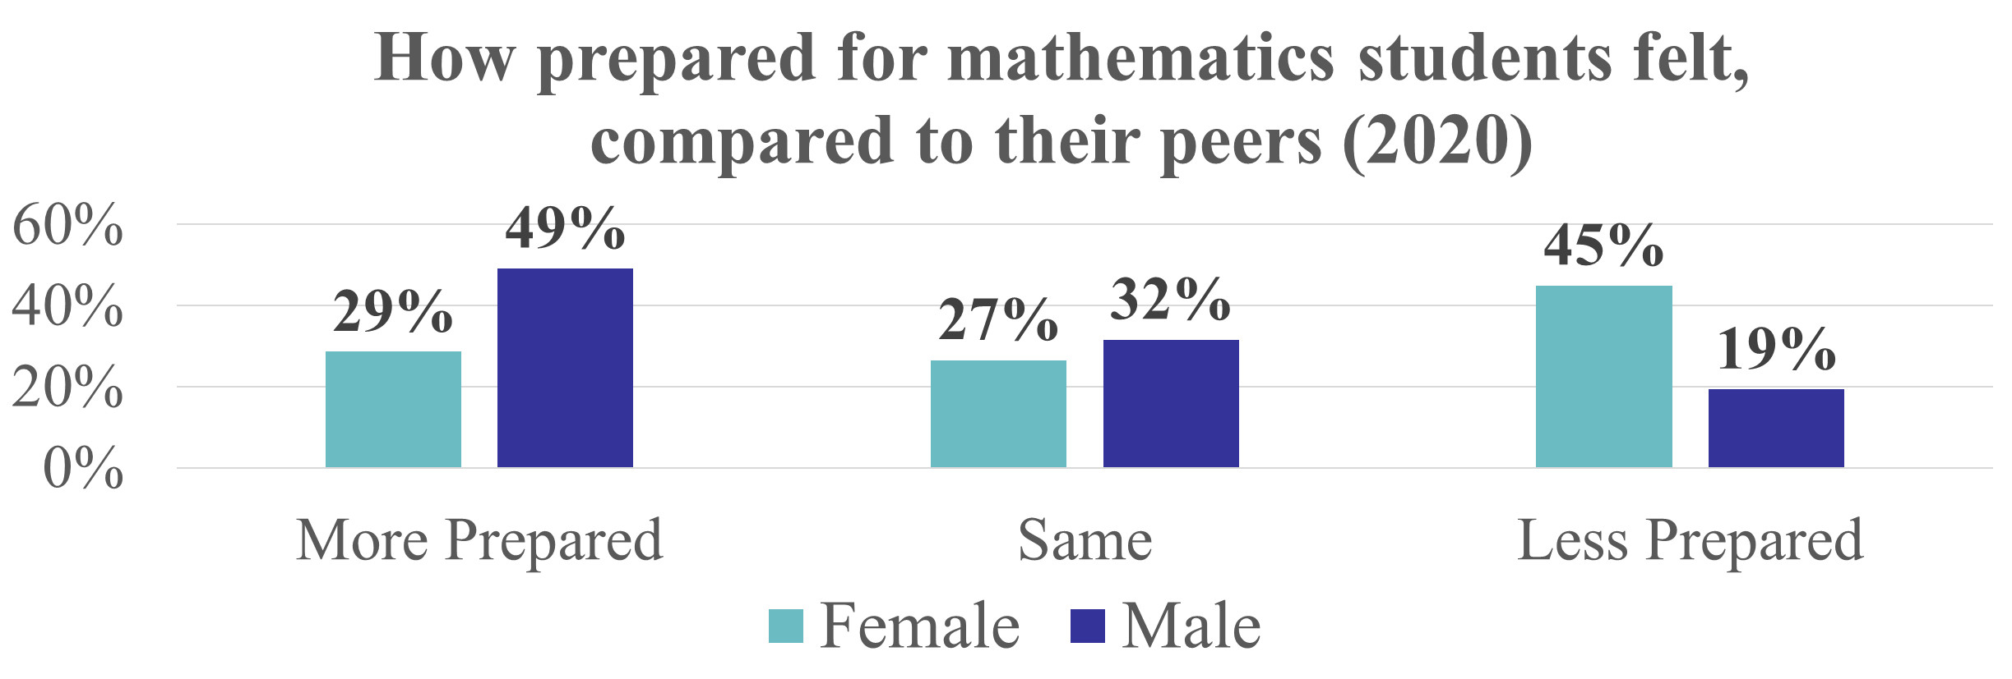
Belonging and Engagement for a Successful Transition
to Higher Education
Sophie McDougall
2324610m@student.gla.ac.uk
About the Project
Social Engagement
2019; 142 responses
2020; 53 responses
This project aimed to explore the factors which impacted new undergraduate physics students transition to higher education at the University of Glasgow
What is Belonging and Engagement?
Sense of Belonging
  Feeling like an ‘integral part of a system or environment’
  As well as feeling accepted and valued by those within this environment [1]
Engagement
  Participation in and out of the academic setting [2]
  Astin’s (1993) theory of involvement implied that the more students were involved at higher education, the more likely they are to be successful [3]
All of the students from 2019 who felt they were less established with new friends at the end of semester one stated they were not enjoying the course
Data Collection
Data Analysis
Students in 2020 have experienced a lack of social engagement due to remote learning
First-year students received two surveys, the first at the beginning of semester one and the second at the end
Second-year students in 2020 received one survey to identify any changes since year 1
Statistical analysis was used to identify any significant results from quantitative data
General inductive coding process was used to identify any key themes from qualitative data
This lead to the majority of
first-year students in 2020 perceiving themselves to be less established with new friends after one semester
Majority of students stated this has made them feel isolated and alone
Gender Disparity in Mathematics
Sense of Belonging
Year 1; 142 responses
Year 2; 32 responses
P-value < 0.05
P-value <0.05
This illiterates that although students felt welcomed by the department in their first year this did not translate into the strong sense of belonging in their second year
Female students initially perceived themselves to be less prepared for maths
2019; 140 responses
2020; 110 responses
Conclusions
References
Female students sense of belonging may be negatively impacted by their lack of self confidence
Remote learning has highlighted the importance of student engagement
Sense of belonging requires ongoing intervention
[1] Hagerty, B. M. K., et al (1992). Sense of belonging: A vital mental health concepts. Archives of Psychiatric Nursing, 6, 172-177
[2] Kuh, G., et al, 2008. Unmasking the Effects of Student Engagement on First-Year College Grades and Persistence. The Journal of Higher Education, 79(5), pp.540-563.
[3] Astin, A. W. (1984). Student involvement: A developmental theory for higher education Journal of College Student Personnel, 25:4, 297–308

